Slide 1

Designing robust force control of Hydraulic Actuators despite system and environmental uncertainties
By:
Navid Niksefat
Nariman Sepehri
Presenter:
Job Ledezma
Genova, Italy – May 2016

Slide 2
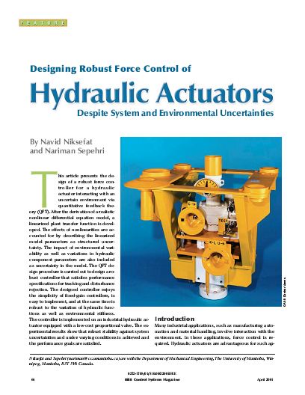
N. Niksefat and N. Sepehri. (2001) Designing Robust Force Control of Hydraulic Actuators Despite System and Environmental Uncertainties. IEEE Control Systems Magazine. 66-77.

Slide 3
Introduction
This article presents the design of a robust force controller for a hydraulic actuator interacting with an uncertain environment via Quantitative Feedback Theory (QFT).
A realistic nonlinear differential equation model is proposed. However, this model is linearized obtaining a plant transfer function where the effects of nonlinearities are accounted as structured uncertainty.
The impact of environmental variability as well as variations in hydraulic component parameters are also included as uncertainty in the model.

Slide 4
Goals
The objective of this study is to evaluate and demonstrate the benefits of QFT when applied to hydraulic force control systems.
For this reason, the QFT technique was employed to design an explicit force controller for an hydraulic actuator and the goal is to arrive at a fixed-gain controller that:
is of low order and easy to implement,
is robust against uncertainties in both environmental stiffness and actuator functions, and
does not require exact knowledge of the system’s parameters.

Slide 5
QFT overview
Quantitative Feedback Theory (QFT) is a frequency domain method intended for practical control system design given robust performance specifications. Its goal is to design a low-bandwidth controller that satisfies performance specifications, despite system uncertainties and disturbances. A low-bandwidth controller is a key issue in any
practical design to avoid problems with noise amplification, resonance, and unmodeled dynamics.

Slide 6
QFT overview
QFT
Was created by the Prof. Isaac Horowitz (1959). It’s a linear technique that adds quantitative characteristic in the frequency analysis initially proposed by Bode (1945).
Quantitative Feedback Theory
Plant model
+
Uncertainties
Performance requirements
Robustness
Performance
Model uncertainties
Disturbances
Bounds
Loopshaping
F
+
G
Quantitative management

Slide 7
QFT overview
QFT is based on a 2-DOF system:
Disturbance at input of the
plant
Disturbance at output of the plant
Controller
Plant
Output
Reference
Prefilter
Sensor
Noise

Slide 8
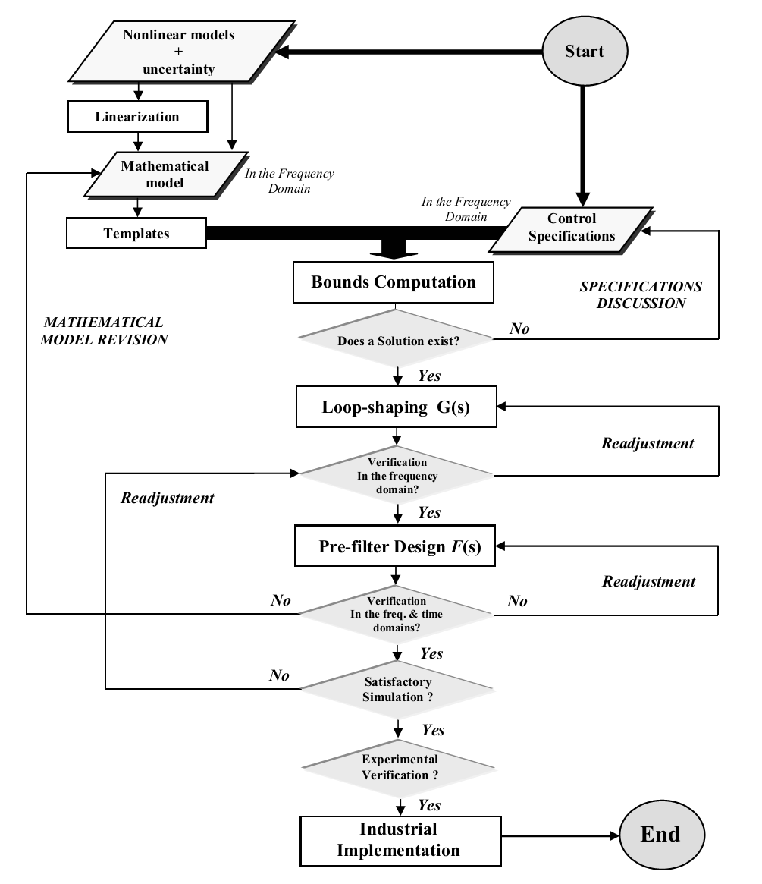
QFT overview
QFT
Procedure

Slide 9
QFT overview
1
Time domain and frequency domain requirements
2
Templates
3
Stability, disturbance and tracking bounds
4
Synthesize nominal L0(s)
5
Loop shaping of the controller G(s)
QFT
Procedure
6
Synthesize the prefilter F(s)
7
Simulations
8
Experimental validation

Slide 10
QFT overview
1
Time domain and frequency domain requirements
TIME DOMAIN SPECIFICATIONS
FREQUENCY DOMAIN SPECIFICATIONS

Slide 11
QFT overview
1
Time domain and frequency domain requirements
Robust stability → δ₁(ω)
Sensitivity → δ₂(ω)
Disturbance rejection → δ₃(ω)
Control effort → δ₄(ω)
Tracking reference
→ δ_{5 inf} (ω) e δ_{5 sup} (ω)

Slide 12
QFT overview
2
Templates
Planta Modelo:
K
a₀
a₁
tal que:
a₀ ∈ [a_{0 min}, a_{0 max}]
a₁ ∈ [a_{1 min}, a_{1 max}]
K ∈ [K_{min}, K_{max}]

Slide 13
QFT overview
2
Templates

Slide 14
QFT overview
3
Stability, disturbance and tracking bounds
Robust stability bound:

Slide 15
QFT overview
3
Stability, disturbance and tracking bounds
Robust stability bound:

Slide 16
QFT overview
3
Stability, disturbance and tracking bounds
Disturbance rejection (Sensitivity at low frequencies):

Slide 17
QFT overview
3
Stability, disturbance and tracking bounds
Disturbance rejection (Sensitivity at medium frequencies):

Slide 18
QFT overview
3
Stability, disturbance and tracking bounds
Disturbance rejection (Sensitivity at high frequencies):

Slide 19
QFT overview
3
Stability, disturbance and tracking bounds
Disturbance rejection

Slide 20
QFT overview
3
Stability, disturbance and tracking bounds
Tracking bound:

Slide 21
QFT overview
3
Stability, disturbance and tracking bounds
Tracking bound:

Slide 22
QFT overview
3
Stability, disturbance and tracking bounds
Intersecting bounds
Joining bounds

Slide 23
QFT overview
3
Stability, disturbance and tracking bounds
Intersecting bounds:

Slide 24
QFT overview
4
Synthesize nominal L0(s)
Integrator:
Proportional gain: 0,038
Zero:
Phase lead filter :

Slide 25
QFT overview
5
Loop shaping of the controller G(s)
Integrator:
Proportional gain: 0,038
Zero:
Phase lead filter :

Slide 26
QFT overview
6
Synthesize the prefilter F(s)
Bode diagram after sinthesizing the prefilter:
Bode diagram before sinthesizing the prefilter:
Pole:
Complex pole:

Slide 27
QFT overview
6
Synthesize the prefilter F(s)
Pole:
Complex pole:

Slide 28
Electrohydraulic Actuator Modeling
Servovalve
Spool movement equation
Flow-rate dynamics
Hydraulic System
Cylinder
Continuity equation
Rod movement equation
Environment
Movement equation

Slide 29
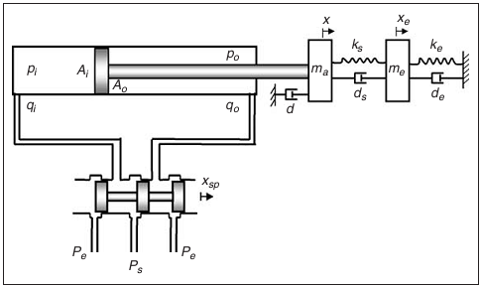




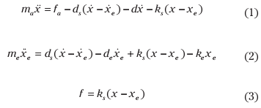



Electrohydraulic Actuator Modeling
Nonlinear differential equations

Slide 30
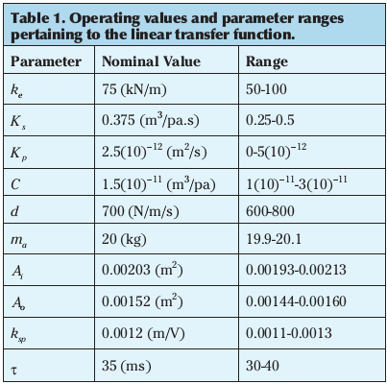

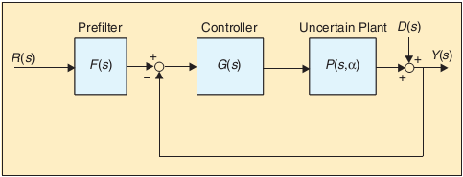
Electrohydraulic Actuator Modeling
Linearized model:
Considering some simplifications:

Slide 31
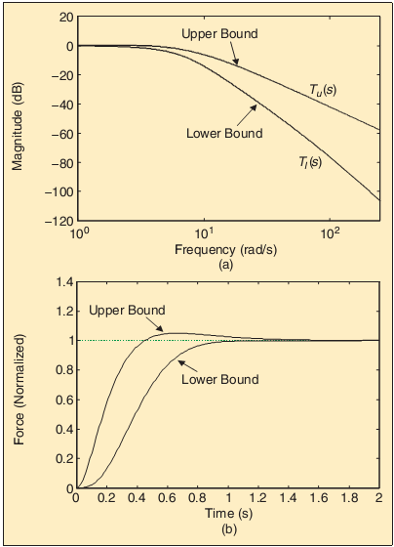


Controller Synthesis
Closed-loop robust stability
The associated QFT robustness constraint in terms of the nominal loop transfer function is given by:
Robust reference input
To meet tracking performance requirements, the controller should satisfy the following inequality:

Slide 32
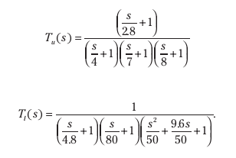
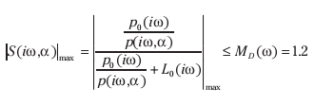
Controller Synthesis
the upper and lower tracking bounds are defined as:
Closed-loop disturbance attenuation (sensitivity reduction)

Slide 33
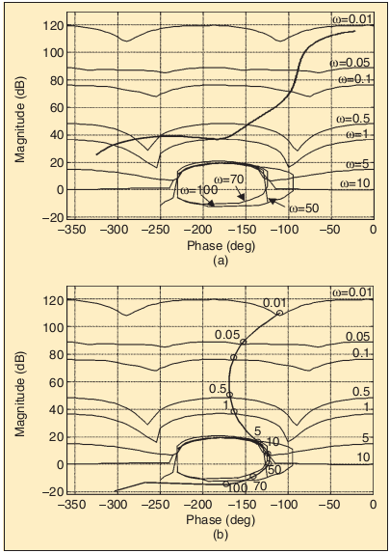
Controller Synthesis
The design specifications impose constraints on the allowable loop gain. These constraints can be shown on a Nichols chart as a curve boundary at each design frequency.
This can be done using a procedure that is called loop shaping in QFT.
Design frequencies are selected as
ω = {0.01,0.05,0.1,0.5,1,5,10,50,70,100} rad/s.

Slide 34
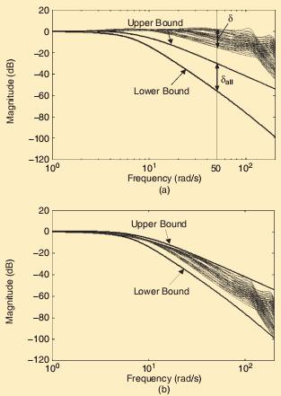
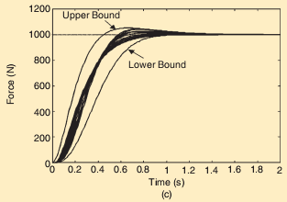
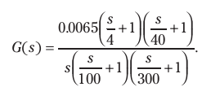
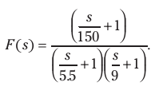
Controller Synthesis

Slide 35
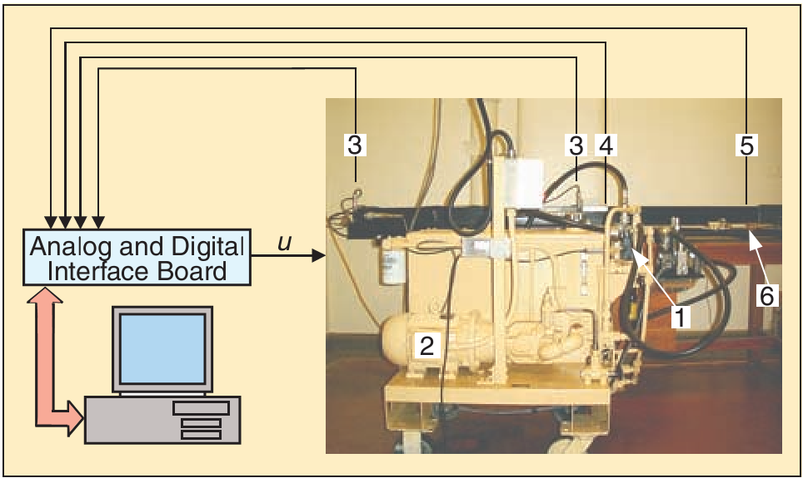
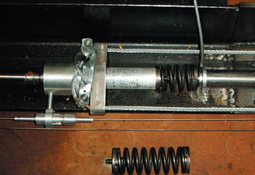
Experiment results
Experimental test station
Proportional valve,
Pump with pressure regulator,
Pressure transducer,
Incremental encoder,
Force sensor,
Environment.

Slide 36
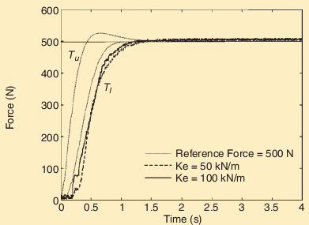
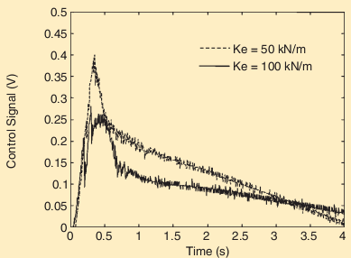
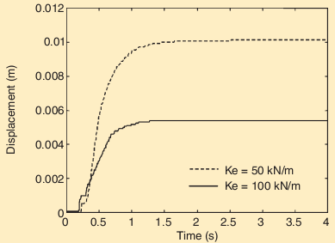
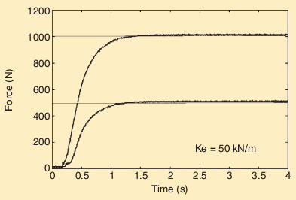
Experiment results

Slide 37
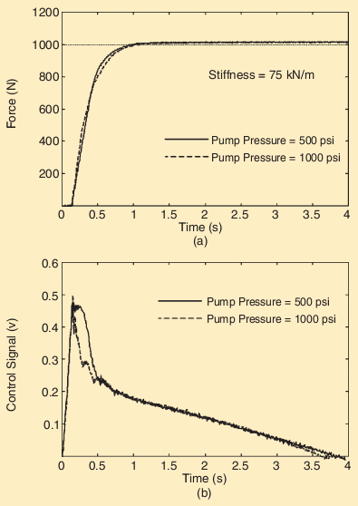
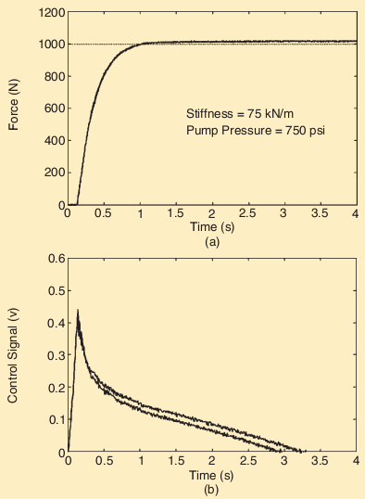
Experiment results

Slide 38
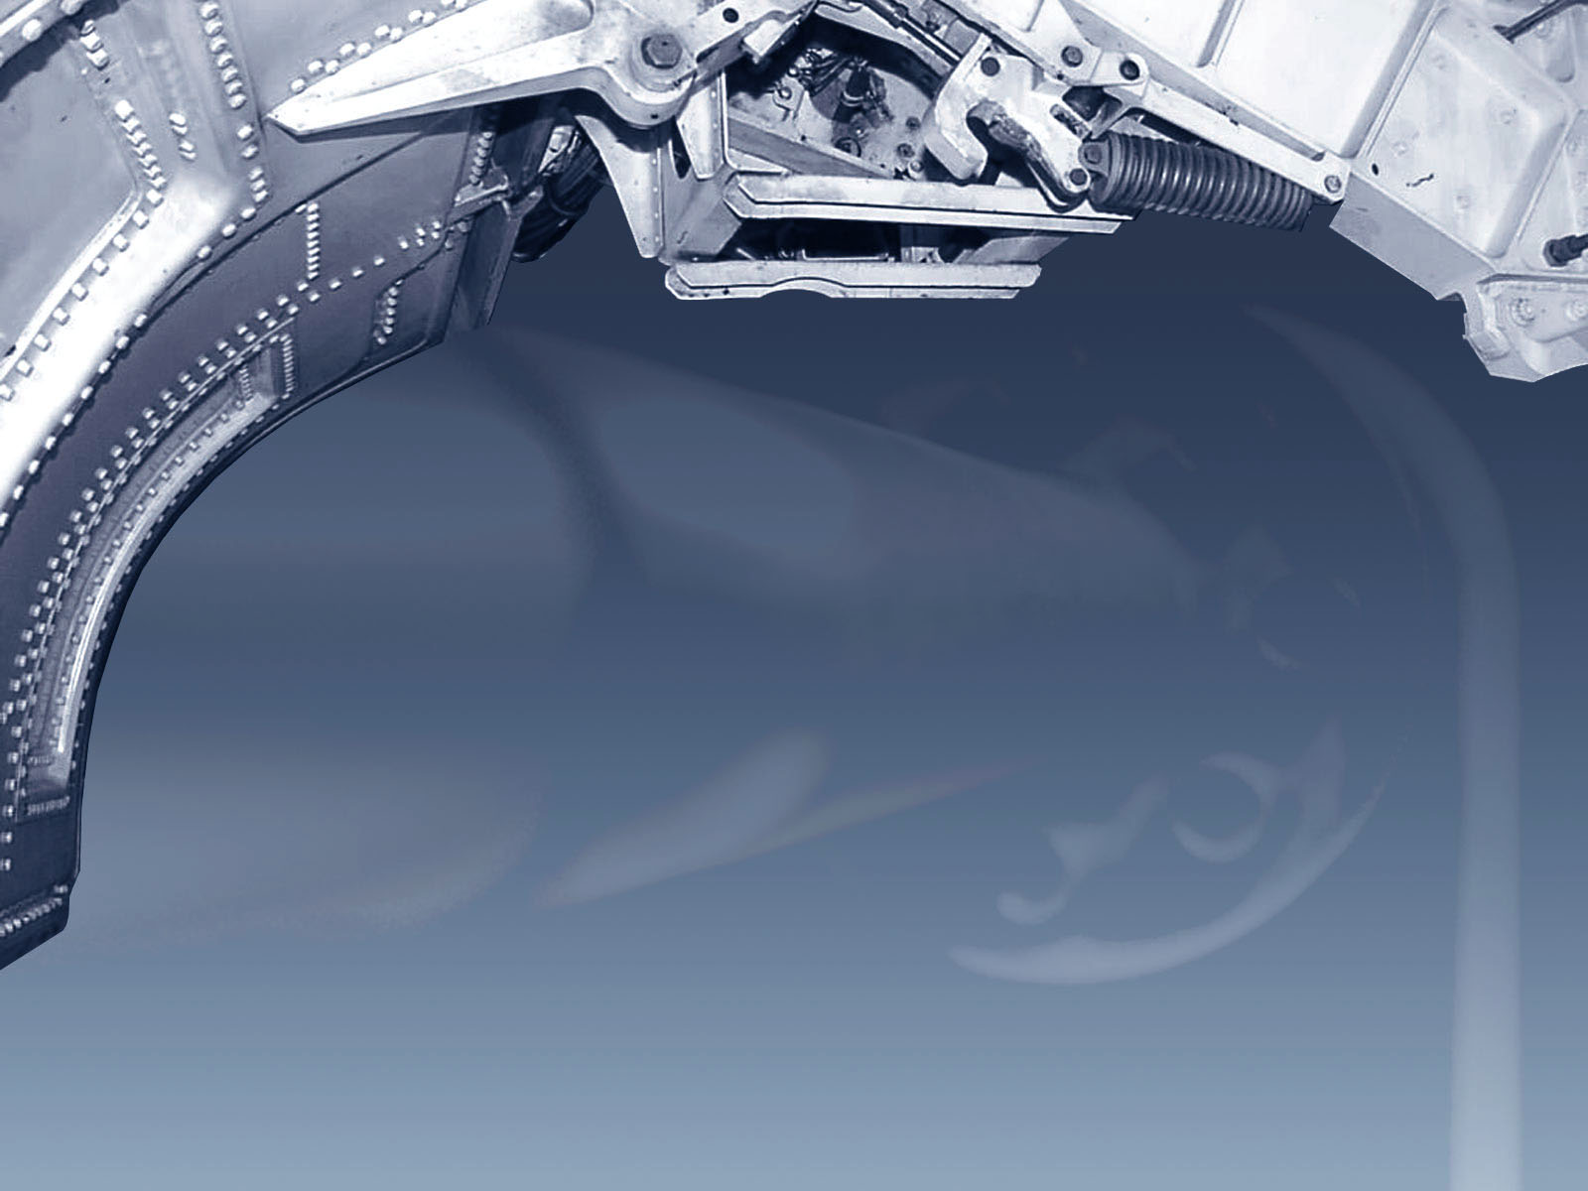
?
?
?
Any questions ??
Thanks !
?

